Slide 1
Global PSP Project for Indian Embassies and Consulates
Quick Guide – Check Passport Quality Screen

Slide 2
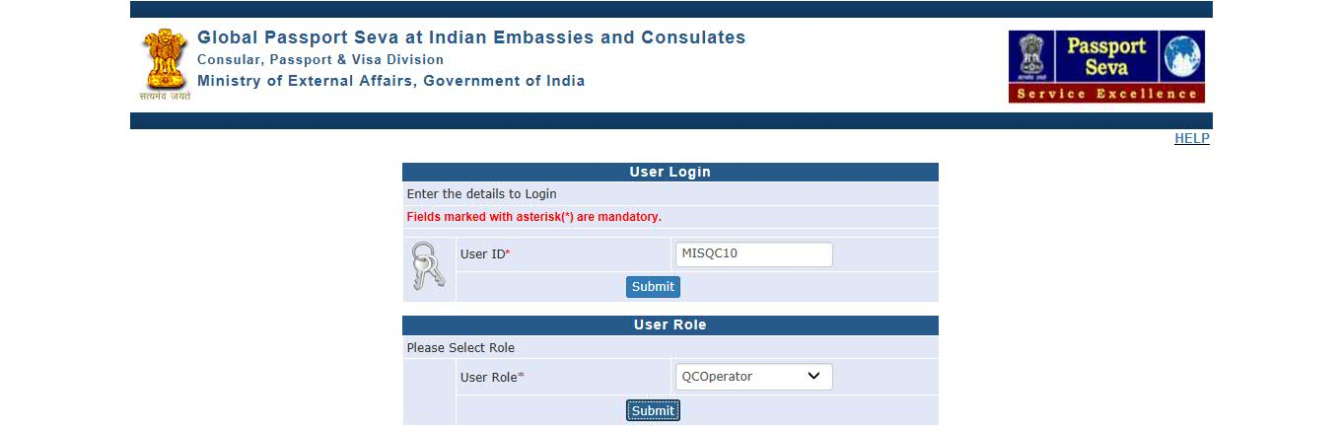
Login Using User ID, Password, and Grid Values
Visit Global PSP Office Portal (https://embassy.passportindia.gov.in)
Enter User ID
Press Submit button
Choose User Role (as QCOperator)
Press Submit button displayed below the User Role

Slide 3
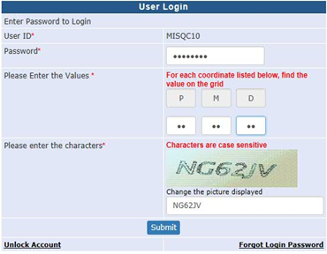
Login Using User ID, Password, and Grid Values (continued..)
Enter Password
Check your User Grid and enter the values for the three alphabets displayed on the screen
Enter the characters displayed in the CAPTCHA image
Press Submit button

Slide 4
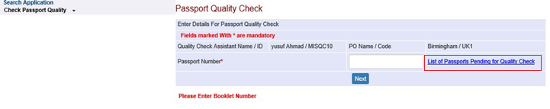
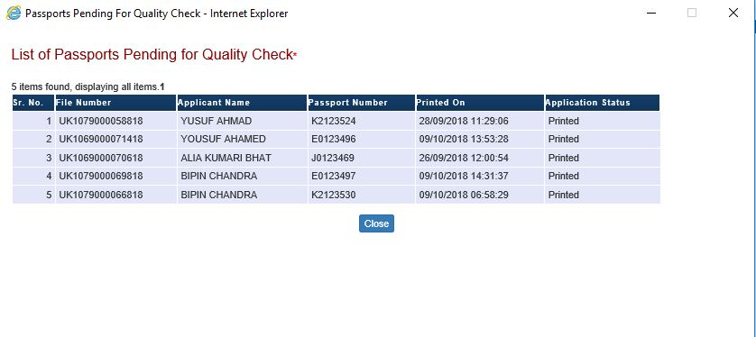
Check Passport Quality screen
List of Passports pending for Quality Check can be viewed by clicking on link “List of Passports pending for Quality Check”

Slide 5
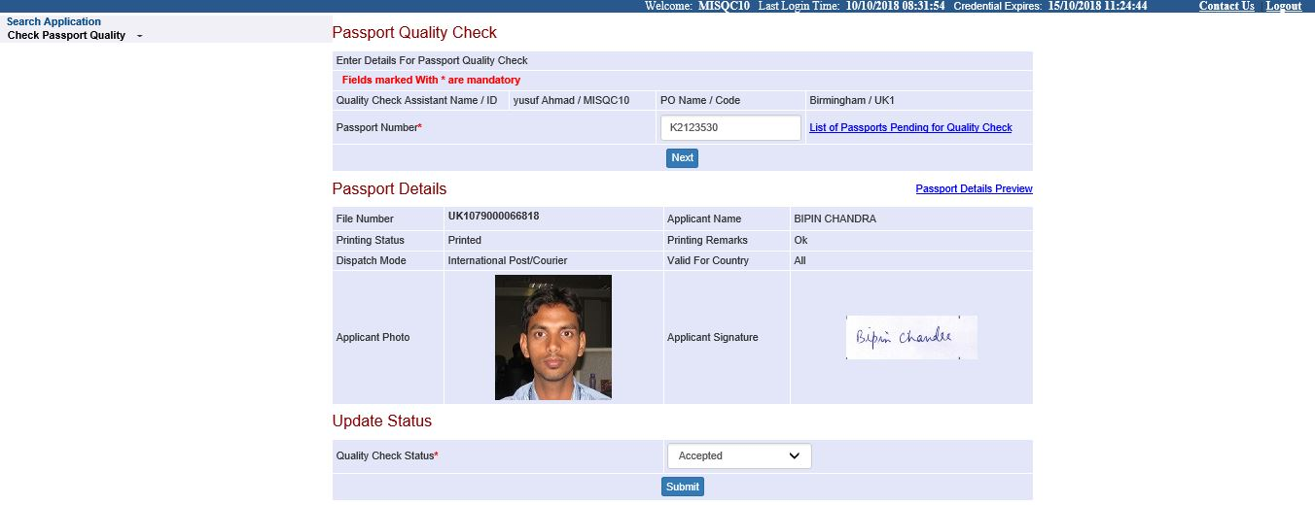
Check Passport Quality screen (continued..) → QC Accepted Case
Enter Passport Number and press the Next button to view details of the Passport (to match with the same printed on the physical passport booklet being checked)
Select Quality Check status as Accepted from drop down

Slide 6
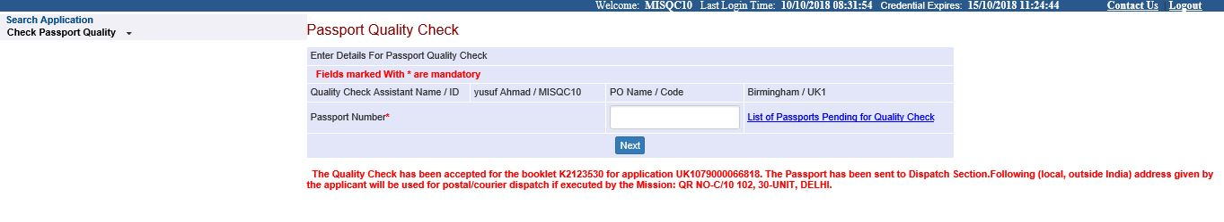
Check Passport Quality screen → QC Accepted Case (continued..)
Press Submit button.
The application workflow moves to the worklist of Dispatch Assistant or Counter Delivery Assistant (as per the Passport Issuance Mode applicable for the case)

Slide 7
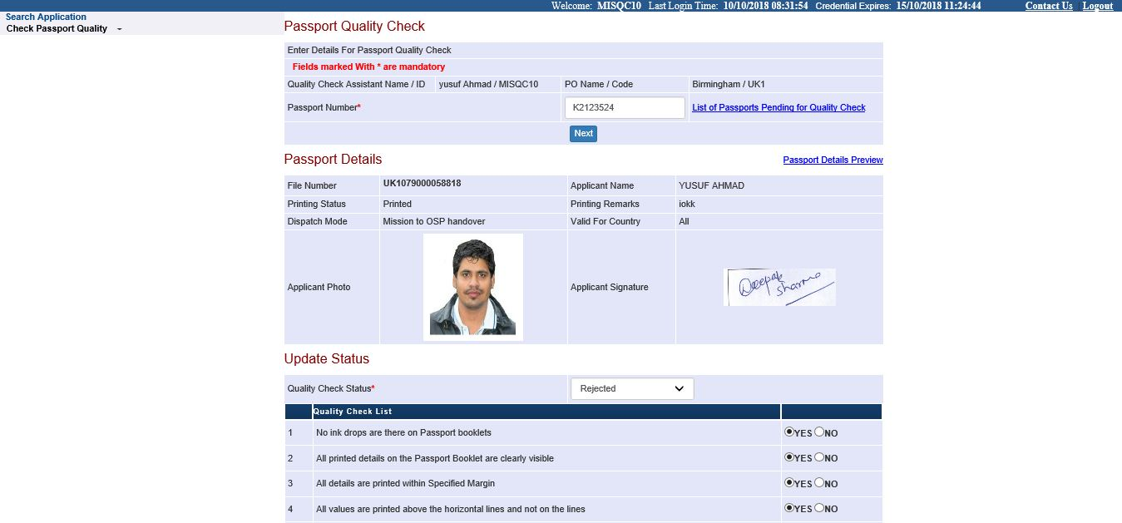
Check Passport Quality screen (continued..) → QC Rejected Case
Enter Passport Number and press the Next button to view details of the Passport
Select Quality Check status as Rejected from drop down
Select reason(s) for QC rejection from amongst the list of QC Check-points displayed on selection of “Rejected” as QC Status

Slide 8
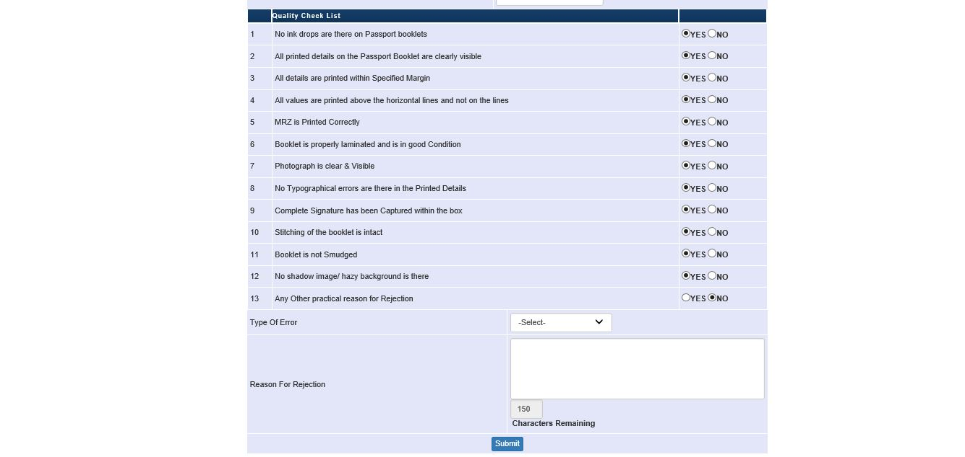
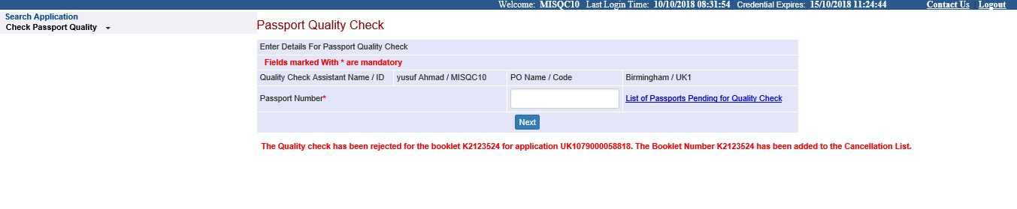
Check Passport Quality screen → QC Rejected Case (continued..)
Enter remarks corresponding to the Reason for Rejection after selecting all the failed QC Check-points
Press Submit button. The application workflow moves to the Review Cancellation List worklist of the PIA users for review

Slide 9
In case of additional information or clarification, please contact Global PSP Support Team at
Email : global.psp@tcs.com
Phone : +91-0120-672-9595/96
Mobile : +91-730-351-9595
Thank You

